Slide 1
Object Oriented Software Engineering (OOSE)
22CS017
Project Scheduling

Slide 2
Index
What is Project Scheduling
Basic Principle of Project Scheduling
Project Scheduling Techniques
Earned Value Analysis
Practice Questions

Slide 3
Introduction to Project Scheduling
Scheduling in project management is the listing of activities, deliverables, and milestones within a project.
A schedule also usually includes a planned start and finish date, duration, and resources assigned to each activity.
Effective project scheduling is a critical component of successful time management.
While discussing the processes for building a schedule, we usually refer to the processes of time management:
Plan schedule management
Define project activities
Sequence activities
Estimate resources
Estimate durations
Develop the project schedule

Slide 4
Planning vs. Scheduling
Understanding the difference between project planning and scheduling is essential to project management.
Project planning requires you to define effective policies and methodologies that can help you achieve your project objectives.
It takes into consideration the entire project, which is why a project plan is typically a more complex and lengthy document that contains the project aims, scope, budgeting, risks and schedule.
Project scheduling consists of assigning start and end dates to individual tasks and allocating appropriate resources within an estimated budget.
This is what allows you to make sure the team can complete their tasks on time. It only focuses on the tasks, their deadlines and project dependencies.
A schedule is an important element of a project plan, while the plan itself is the overall set of guidelines for all aspects of a project.

Slide 5
Project Scheduling
Project-task scheduling is a significant project planning activity. It comprises deciding which functions would be taken up when.
To schedule the project plan, a software project manager wants to do the following:
Identify all the functions required to complete the project.
Break down large functions into small activities.
Determine the dependency among various activities.
Establish the most likely size for the time duration required to complete the activities.
Allocate resources to activities.
Plan the beginning and ending dates for different activities.
Determine the critical path. A critical path is the group of activities that decide the duration of the project.

Slide 6
Project Scheduling Basic Principles
Compartmentalization. The project must be compartmentalized into a number of manageable activities and tasks.
Interdependency. The interdependency of each compartmentalized activity or task must be determined. Some tasks must occur in sequence, while others can occur in parallel. Some activities cannot commence until the work product produced by another is available. Other activities can occur independently.
Time allocation. Each task to be scheduled must be allocated some number of work units (e.g., person-days of effort). In addition, each task must be assigned a start date and a completion date and whether work will be conducted on a full-time or part-time basis.

Slide 7
Project Scheduling Basic Principles
Effort validation. Every project has a defined number of people on the software team. As time allocation occurs, you must ensure that no more than the allocated number of people have been scheduled at any given time.
Defined responsibilities. Every task that is scheduled should be assigned to a specific team member.
Defined outcomes. Every task that is scheduled should have a defined outcome. For software projects, the outcome is normally a work product or a part of a work product.
Defined milestones. Every task or group of tasks should be associated with a project milestone. A milestone is accomplished when one or more work products has been reviewed for quality and has been approved.

Slide 8
Project Scheduling Techniques
1. Mathematical Analysis
Critical Path Method (CPM) and Program Evaluation and Review Technique (PERT) are the two most commonly used techniques by project managers. These methods are used to calculate the time span of the project considering the scope of the project.
Critical Path Method: Critical path is the set of sequential activities from start to the end of a project. If there is a delay in any of the activities under the critical path, there will be a delay of the project deliverables. Most of the times, if such delay is occurred, project acceleration or re-sequencing is done in order to achieve the deadlines.
In the critical path method, the critical activities of a program or a project are identified. It is based on mathematical calculations and it is used for scheduling project activities. This method was first introduced in 1950s as a joint venture between Remington Rand Corporation and DuPont Corporation. Although the original method was developed for construction work, this method can be used for any project where there are interdependent activities.

Slide 9
Project Scheduling Techniques
Program Evaluation and Review Technique (PERT)
The Program Evaluation Review Technique, or PERT, is a visual tool used in project planning. Using the technique helps project planners identify start and end dates, as well as interim required tasks and timelines. The information is displayed as a network in chart form.
PERT was developed by the U.S. Navy in the 1950s to help create a business plan that would coordinate the thousands of contractors it had working on myriad projects.
PERT helps project planners identify:
Start and end dates
All activities, referred to as events on the chart, that impact the completion time
The required sequence of events
The probability of completion by a certain date

Slide 10
Project Scheduling Techniques
2. Duration Compression
Duration compression helps to cut short a schedule if needed. It can adjust the set schedule by making changes without changing the scope in case, the project is running late. Two methodologies that can be applied:
Fast Tracking: Fast-tracking is another way to use CPM.
Fast-tracking finds ways to speed up the pace at which a project is being implemented by simultaneously executing many tasks or by overlapping many tasks to each other.
CPM helps us identify activities that can be used to speed up the pace of the project. Although it is an appealing technique, it has its own share of risks too.
As many activities will be simultaneously implemented, it is highly to make mistakes and compromise on quality.

Slide 11
Project Scheduling Techniques
Crashing
Crashing deals with involving more resources to finish the project on time. For this to happen, you need spare resources to be available at your disposal.
Need to add new team members to a project and limited divisibility of tasks leads to increase in cost.
The crashing technique can also be used by adding time, paid overtime, but it should stay within the decided deadline.
It, unfortunately, leads to raising the cost of the project.

Slide 12
Project Scheduling Techniques
3. Task List
The task list is the simplest project scheduling technique of all the techniques available.
Documented in a spreadsheet or word processor is the list of all possible tasks involved in a project.
This method is simple and the most popular of all methods.
It is very useful while implementing small projects.
But for large projects with numerous aspects to consider task list is not a feasible method.

Slide 13
Project Scheduling Techniques
4. Gantt Chart
Gantt charts was devised by Henry Gantt (1917). For tracking progress and reporting purposes, the Gantt Chart is a visualization technique used in project management.
It is used by project managers most of the time to get an idea about the average time needed to finish a project.
A project schedule Gantt chart is a bar chart that represents key activities in sequence on the left vs time.
Each task is represented by a bar that reflects the start and date of the activity, and therefore its duration.

Slide 14
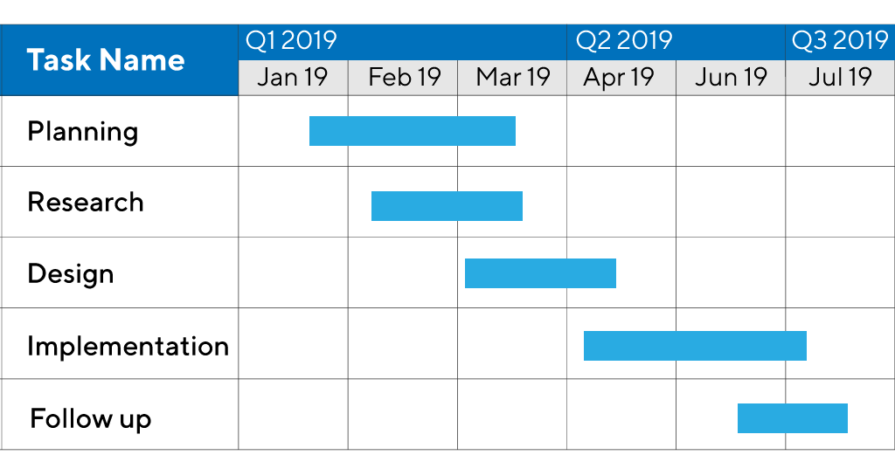
Project Scheduling Techniques
Gantt Chart Example
Figure 1: Gantt Chart

Slide 15
Earned Value Analysis
Earned Value Analysis is a quantitative technique for assessing progress as the software project team moves through the work tasks, allocated to the Project Schedule.
Total hours to complete the project are estimated and every task is given an Earned Value, based on its estimated (%) of the total.
The earned value system provides a common value scale for every software project task, regardless of the type of work being performed. The total hours to do the whole project are estimated, and every task is given an earned value based on its estimated percentage of the total.
Stated even more simply, earned value is a measure of progress. It enables you to assess the “percent of completeness” of a project using quantitative analysis rather than rely on a gut feeling.

Slide 16
Earned Value Analysis
Planned Value (PV) – The approved cost baseline for the work package. It is also known as Budgeted Cost of Work Scheduled (BCWS).
Earned Value (EV) – The budgeted value of the completed work packages. It is also known as Budgeted Cost of Work Performed (BCWP) at a specified point.
Actual Cost (AC) – The actual cost incurred during the execution of work packages up to a specified point in time. It is also known as Actual Cost of Work Performed (ACWP).

Slide 17
Earned Value Analysis - Steps
The budgeted cost of work scheduled (BCWS) is determined for each work task represented in the schedule. During estimation, the work (in person-hours or person-days) of each software engineering task is planned. Hence, BCWS_{i} is the effort planned for work task i. To determine progress at a given point along the project schedule, the value of BCWS is the sum of the BCWS_{i} values for all work tasks that should have been completed by that point in time on the project schedule.
The BCWS values for all work tasks are summed to derive the budget at completion (BAC). Hence,
Next, the value for budgeted cost of work performed (BCWP) is computed. The value for BCWP is the sum of the BCWS values for all work tasks that have actually been completed by a point in time on the project schedule.

Slide 18
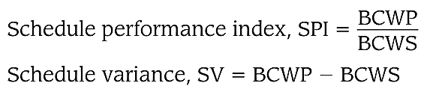


Earned Value Analysis - Steps
SPI is an indication of the efficiency with which the project is utilizing scheduled resources. An SPI value close to 1.0 indicates efficient execution of the project schedule.
SV is simply an absolute indication of variance from the planned schedule.
Percent scheduled for completion provides an indication of the percentage of work that should have been completed by time t.
Percent complete provides a quantitative indication of the percent of completeness of the project at a given point in time t.

Slide 19
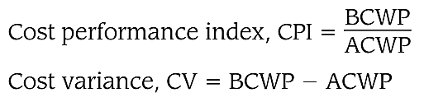
Earned Value Analysis - Steps
It is also possible to compute the actual cost of work performed (ACWP).
The value for ACWP is the sum of the effort actually expended on work tasks that have been completed by a point in time on the project schedule.
A CPI value close to 1.0 provides a strong indication that the project is within its defined budget.
CV is an absolute indication of cost savings (against planned costs) or shortfall at a particular stage of a project.

Slide 20
Practice Questions
Q1 - Which of the following is a project scheduling method that can be applied to software development?
PERT
CPM
CMM
Both PERT and CPM
Q2 - A project usually has a timeline chart which was developed by
Henry Gantt
Barry Boehm
Ivar Jacabson
None of the mentioned
Q3 - The customer is looking for the project to be complete 10 days earlier than planned due to marketing constraints. You work with your project team and figure out that this can be achieved if a couple of activities can overlap. This approach is known as?
Crashing
Resource Leveling
Concurrent Engineering
Fast Tracking

Slide 21
Bibliography
https://www.javatpoint.com/software-engineering-project-scheduling
https://www.geeksforgeeks.org/short-note-on-project-scheduling/
https://uk.indeed.com/career-advice/career-development/project-scheduling
https://learnerbits.com/unit-3-project-scheduling/
https://www.getclockwise.com/blog/project-management-scheduling-techniques

Slide 22
THANK YOU

